Slide 1
Introduction to SAD and SDLC
School of Computing and Engineering

Slide 2
Learning Objectives
Understand Systems Analysis and Design concepts;
Describe Systems Development Lifecycle (SDLC);
Learn System Analyst role and skills.

Slide 3
What is a system?

Slide 4
System
A system is a set of connected components that function together to achieve a common goal.
The components of the system are interdependent (the function of one component effects the other one).
Components interact to achieve the system’s goal.
A system receives input which is then transformed into output.

Slide 6
What is systems analysis and design?

Slide 7
Answer:
Systems analysis and design is a method used by companies to create and maintain information systems that perform basic business functions
The main goal is to improve the company's systems to help employees accomplish business goals
[2]

Slide 8

Systems Analysis and Design
In Systems Analysis and Design we study existing systems to formulate the requirements for a new system
To do this we ask,
What is the problem with the existing system?
What is the best solution to address this problem?

Slide 9
What is systems development life cycle?

Slide 10




Systems Development Life Cycle (SDLC)
SDLC is the development of a system according to a framework of activities and tasks
Implementation
Design

Slide 11
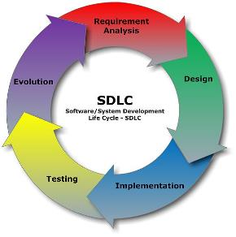
SDLC
The systems development life cycle (SDLC) is the process of determining how a system can support the organizations needs
Designing the system
Building the system
Delivering the system
[4]

Slide 12
SDLC
The SDLC is composed of four fundamental phases:
Planning
Analysis
Design
Implementation
Each of the phases is composed of steps, which rely on techniques that produce deliverables

Slide 13
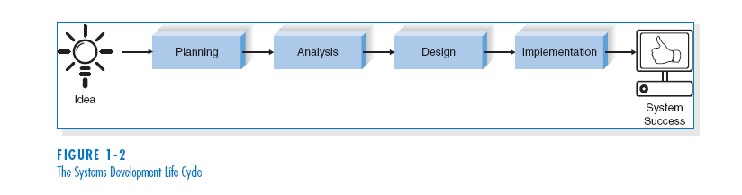
THE SYSTEMS DEVELOPMENT LIFE CYCLE (SDLC)
[4]

Slide 14
Phases Common to All SDLCs
Planning
why build the system?
Analysis
who, what, when, where will the system be?
Design
how will system work?
Implementation
How will system be delivered and maintained
Notes:
Fundamental four-stage systems development life cycle

Slide 15
Planning
This phase is the fundamental process of understanding why an information system should be built
.
The planning phase has two steps:
We identify the system’s business value to the organization. Determine if the system is cost efficient (How will it lower costs or increase revenues?).
If the system is feasible, then the project manager creates a work plan to direct the project through the SDLC.

Slide 16
Analysis
The analysis phase answers the questions of who will use the system, what the system will do, and where and when it will be used.
During this phase the project team investigates current systems, identifies improvement opportunities and develops a concept for the new system.

Slide 17
The analysis phase has three steps:
Analysis strategy: This includes a study of the current system, its problems; and then envisioning how the new system will operate, how it will achieve its goal.
2. Requirements gathering: The analysis of key information leads to the development concept for the new system.
3. System proposal: The proposal is presented to the project sponsor and other key individuals who decide whether the project should continue to move forward.

Slide 18
Design
The design phase decides how the system will operate, in terms of the hardware, software, and network infrastructure; as well as the user interface, input forms and reports that will be used; and the specific programs, databases that will be needed. (MySQL, SQL Server, SQLite, MongoDB)

Slide 19
The design phase has four steps:
Design Strategy: This clarifies whether the system will be developed by the company or outside the company.
2. Architecture Design: This proposes the hardware, software, and network infrastructure (Local services or Web Services (Azure, AWS) that will be used.
3. Database Specifications: These documents define what and where the data will be stored.
4. Program Design: Defines what programs need to be coded/developed and what they will do.

Slide 20
Implementation
During the implementation phase, the system is developed and installed.
This phase is usually the longest and most expensive part of the process.

Slide 21
The implementation phase has three steps:
System Construction: The system is built and tested to make sure it performs as designed.
2. Installation: The old system is turned off and the new one is turned on.
3. Support Plan: Includes a post-implementation review to provide a way to add future functionality.

Slide 22
Identify the steps required for each phase :
Planning:
Analysis:
Design:
Implementation:

Slide 23
References
Dennis, A., and Wixom, B. H, “Systems Analysis and Design”, 5th Edition, John Wiley & Sons (2013), Chapter one.
Hoffer, V.G. “Essentials of Systems Analysis & Design”, 5th Edition, Pearson (2014)

